Slide 1
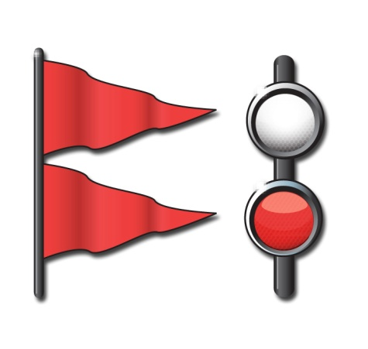
Chapter 5
Boating Emergencies…What to Do
Notes:
Chapter 5 we talked about “The Legal Requirements of Boating”.
Chapter 6 we will be discussing “Boating Emergencies…What to Do”
There is a difference between what the minimum law requirements are and what a prudent mariner carries on a boat.

Slide 2
Key Topics
Risk Management
Boating Accidents
Personal Injuries
Weather Emergencies
Summoning Help
Notes:
Mention these items as an overview of this chapter. More detail will be covered on each topic.
When you go boating. You will encounter hazards and risks.
It’s important to make a boating emergency less likely to happen by taking the proper precaution; but it’s equally important to be prepared and know what to do if an emergency occurs.
Mention these items as an overview of this chapter. More detail will be covered on each topic.
When you go boating. You will encounter hazards and risks.
It’s important to make a boating emergency less likely to happen by taking the proper precaution; but it’s equally important to be prepared and know what to do if an emergency occurs.

Slide 3
Objectives
You should be able to…
Explain how to practice risk management while boating.
Describe the effects of boating stressors.
Explain how dehydration occurs and how to recognize and prevent it.
Explain the increased effects of alcohol on the body when on the water.

Slide 4
Objectives
Find the personal flotation device (PFD) that is the proper size for the wearer and check a PFD’s condition.
Explain how to handle situations involving capsizing, swamping, or falling overboard.
Avoid collisions.
Respond properly to a fire emergency.
Take the proper steps if a vessel runs aground.

Slide 5
Objectives
Explain the danger and stages of cold water immersion and what to do to survive.
Recognize the symptoms of carbon monoxide poisoning and explain how to prevent it.
Obtain weather forecasts, recognize weather warnings, and explain what to do if caught in severe weather.
Summon help quickly if a serious boating emergency occurs.

Slide 6
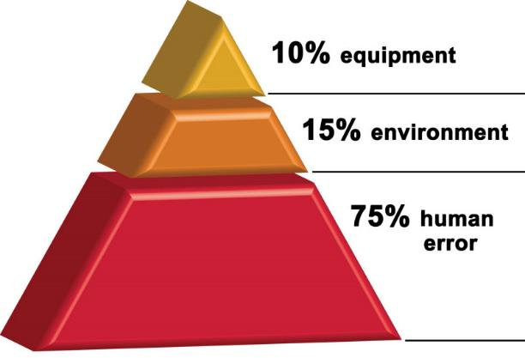
Risk Management
Profile of a Typical U.S. Boating Fatality
PFDs are on board but not in use
Vessel is small boat of open design
⅓ of time alcohol is involved
Daylight, good weather
Operator is male, 26 to 50, with boating experience
Nearly all accidents are preventable
Notes:
In fatal boating accidents >80% had no training
87% had no life jacket
A large % include alcohol
Most fatalities were swimmers

Slide 7
Risk Management
Risk management is:
Recognizing dangerous situations and reducing chance that they will happen.
Lessening effects of accidents if they do happen.
Notes:
Ask students to think about what they learned in the previous chapters. How can they reduce the risk of accidents?

Slide 8
Risk Management
Increased Risk Due to Boating Stressors
Stressors such as sun’s glare and heat, motion, and engine noise and vibration increase the risk of a boating accident.
Stressors weaken your body and mind enough to make the risk of an accident greater.
Notes:
Ask: What are three of the natural stressors that can effect boaters?
Motion
Noise
Vibration

Slide 9
Risk Management
Increased Risk Due to Dehydration
Boating causes you to generate more body heat.
This makes you sweat more.
Dehydration makes you tired and increases risk for an accident.
The result can be dehydration.
Notes:
If a class member has experienced dehydration, ask them to explain what it was like.
If no one responds, ask students what causes are

Slide 10
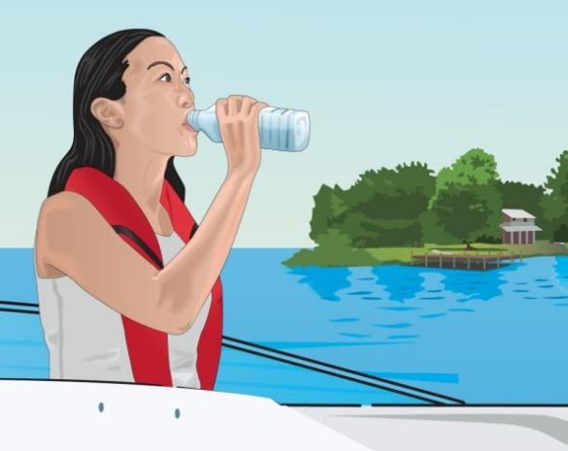
Risk Management
Increased Risk Due to Dehydration
To prevent dehydration, drink some water every 15–20 minutes.
If dehydration occurs, drink plenty of water and get out of the sun.
Notes:
Most people wait to drink water until they feel thirsty. If you feel thirsty you are already experiencing dehydration.

Slide 11
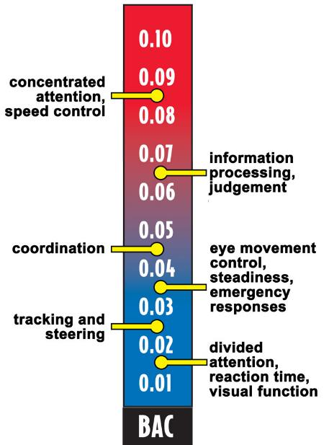
Risk Management
Blood Alcohol Concentration (BAC)
Avoiding Alcohol
Alcohol increases natural stressors.
It takes less alcohol to make a person legally intoxicated on water.
Notes:
Discuss the legal limits of alcohol consumption for the state in which you are teaching.
Remind the participants that using drugs and/or alcohol while boating is a leading cause of boating accidents.
Discuss the legal limits of alcohol consumption for the state in which you are teaching.
Remind the participants that using drugs and/or alcohol while boating is a leading cause of boating accidents

Slide 12
Risk Management
Drinking while boating increases likelihood of accidents.
Make sure everyone wears a PFD.
Designate non-drinking boaters to operate the vessel.
Notes:
It is always a good idea that at east 2 people avoid drinking while on the boat in case something happens to the operator.

Slide 13
Risk Management
To minimize the risk of an accident–Don’t drink and boat!
Notes:
Emphasize the number of boating accidents and death attributed to boating under the influence. Remind students of the penalties within your state for BUI.

Slide 14
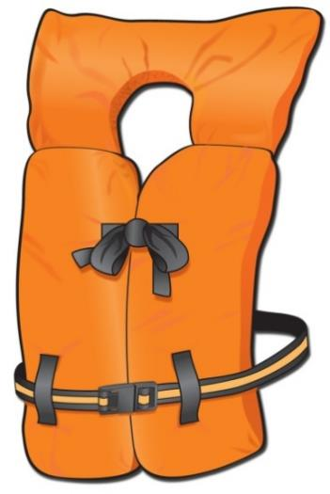
Risk Management
Minimize Risk of Drownings—Wear PFDs
Have everyone on board wear a PFD.
Follow the requirements:
Readily accessible
Proper size
Good and serviceable condition
Notes:
Instructor Notes:
Discuss what is “readily accessible”.
Classroom aid: Demonstrate the test for proper fit. Using a student, place a PFD that is too large on the student and show how the PFD will come off when the person falls into the water.

Slide 15
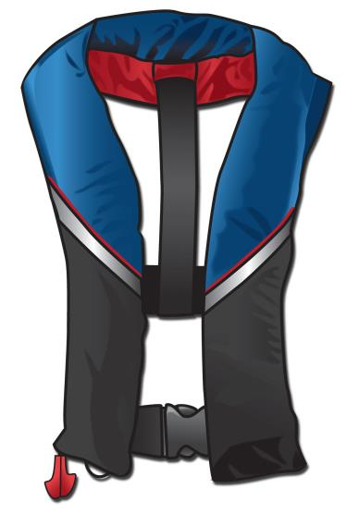
Minimize Risk of Drowning
Inflatable PFDs
Come in two styles.
Inflate if wearer falls into the water.
Are approved for ages 16 or older.
Come with operating instructions.
Notes:
When purchasing an inflatable PFD always check that there is aCO2 cartridge contained in it. While rare, some purchased might be missing it. Remind students of your state’s inflatable PFD laws, when they can be used and when they cannot.

Slide 16
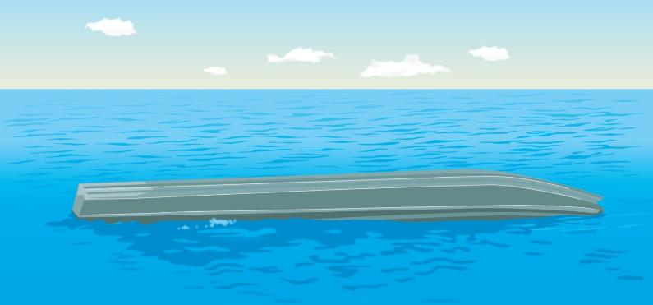
Boating Accidents
Capsizing, Swamping, or Falling Overboard
Capsizing―boat turns on its side or turns completely over.
Swamping―boat stays upright and fills with water.
Notes:
Review the definition of “capsize” and “swamping.” Both are dangerous, can be more so in cold water and weather.

Slide 17
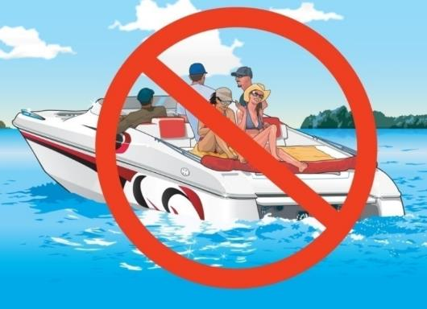
Boating Accidents
Capsizing, Swamping, or Falling Overboard
For safety:
Ask everyone to wear a PFD.
Attach engine cut-off switch lanyard to wrist, clothes, or PFD.
Don’t allow anyone to sit on any area not designed for seating.
Notes:
You should always have an engine cut-off switch. This will prevent the boat from running if the operator falls overboard.

Slide 18
Boating Accidents
Don’t overload your boat.
Keep centered in the boat with your center of gravity low.
Don’t let anyone lean a shoulder beyond gunwale in a small boat.
Slow down when turning.
Don’t boat in rough water or bad weather.
Secure anchor line to the bow.
Notes:
In order to prevent capsizing, be sure to follow these rules.

Slide 19
Boating Accidents
If you capsize or swamp your boat or fall overboard:
Stay with the boat.
Put a PFD on. Have your passengers do the same.
Take a head count.
Signal for help.
Notes:
Always stay with the boat. It will present a larger target for search and rescue personnel to find you. It will also help keep you out of the cold water.

Slide 20
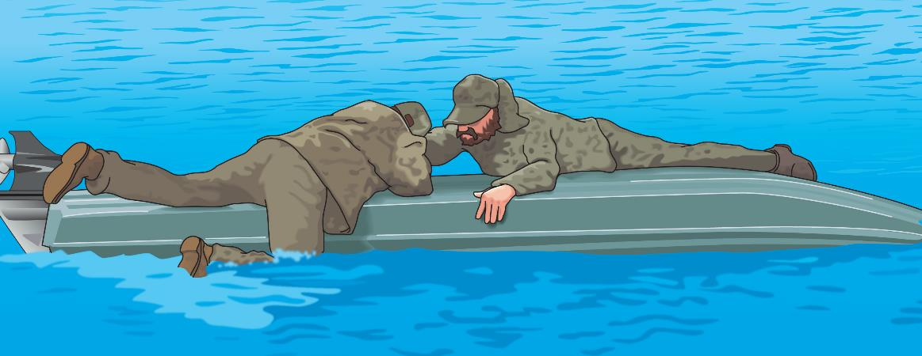
Boating Accidents
If your boat is still floating, try to reboard or climb onto it.
If your boat sinks or floats away, look for other items to help support you.

Slide 21
Boating Accidents
If boat sinks or floats away:
Don’t panic―remain calm and wait for help.
Make sure your PFD is securely fastened, or find something to help you float.
Notes:
Emphasize this as a reason to ALWAYS wear the life jacket, and not have it only readily accessible. Once in the water, it is nearly impossible to put the PFD on. If a person had hit their head or it hurt, they cannot put one one at all. It should be on at all times.

Slide 22
Boating Accidents
If someone falls overboard:
Shout “Man Overboard.”
Slow down.
Toss the victim a PFD.
Slowly pull alongside the victim.
Stop the engine.
Pull aboard at the stern.
Notes:
Discuss why each item is important. Remind the participants that the first person to see someone go overboard should shout so loudly, ensuring the helmsman hears. Discuss why you pull the person aboard at the stern: lowest point of the boat, perhaps swim platform. Be sure engine is off.

Slide 23
Boating Accidents
Avoiding Collisions
Follow the rules of navigation.
Pay attention to navigation aids.
Keep a sharp watch and appoint a lookout.
Maintain a safe speed.
Notes:
Remind students why these rules are important and how they can prevent collision. The primary causes of boating accidents include not having a proper lookout, not maintaining a safe speed, and drinking while boating.

Slide 24
Boating Accidents
Look in all directions before turning.
Use caution when traveling into the sun’s glare.
Never operate when fatigued or stressed, or while consuming alcohol.
Watch for floating debris.

Slide 25
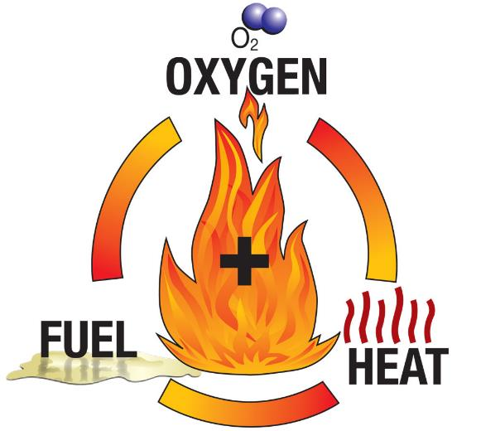
Boating Accidents
Dealing With Fire Emergencies
To prevent a fire:
Don’t mix fuel, oxygen, and heat.
Make sure ventilation systems are working.
Maintain the fuel system.
Use safe fueling procedures.

Slide 26
Boating Accidents
If a fire starts:
Stop the boat.
Position the fire downwind.
Shut off fuel supply, if fire is in the engine.
Use the fire extinguisher (remember PASS).
Summon help.
How is a fire on a PWC different than other vessels?
Notes:
Ask: Ask the question and look for the following answers:
Alert crew
Put on PFDs
Turn off fuel
Disconnect electricity
Identify source of fire
Can you fight fire
If not get off boat
Call for help
Emphasize swimming away from the PWC until help arrives. Look for the following answers from the students:
Stop the engine
Take distress signals, swim away
Keep riders together until help arrives

Slide 27
Boating Accidents
Running Aground
To prevent:
Know your boating environment.
Find out the location of shallow water and submerged objects.
Learn to read nautical charts.
Notes:
Ask: How can you tell the depth of water? Responses could include:
Depth finder
Chart
Lead line

Slide 28
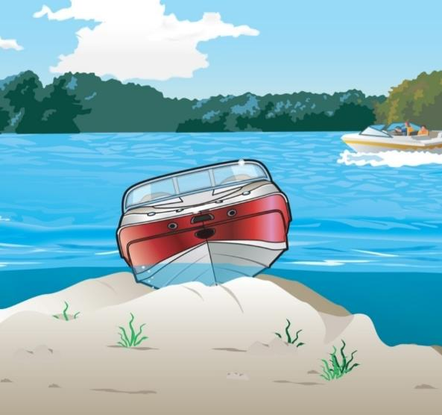
Boating Accidents
If you run aground:
Make sure no one is injured.
Check for leaks.
Try to get loose.
Signal for help if needed.
Notes:
The instructor should emphasize:
Check hull for damage
Check tide
Shift weight to reduce draft
PFDs and safety lines
If stuck, use visual distress signals

Slide 29
Personal Injuries
Cold Water Immersion and Hypothermia
Kill in several ways.
Can cause a reaction in water as warm as 77°F.
Understand how your body reacts to cold water to respond appropriately and increase your chance of survival.
Notes:
Ask the question. Look for these answers:
Shivering
Bluish lips and fingers
Loss of feeling in hands and feet
Cold bluish skin
Decreased mental skills
Slurred speech and blurred vision
Rigidity in hands and feet
Unconsciousness
Coma

Slide 30
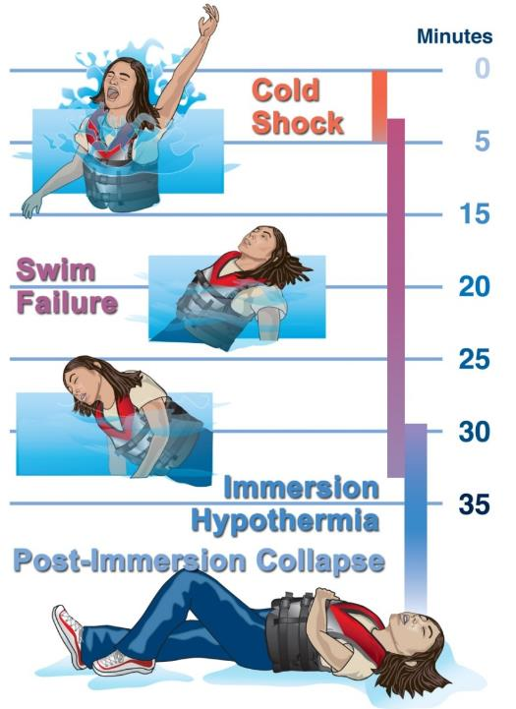
Cold Water Immersion
Stages of Cold Water Immersion
Stage 1
Initial “cold shock”
Occurs first 3–5 minutes
Stage 2
Short-term “swim failure”
Occurs 3–30 minutes following immersion
Stage 1
Stage 2

Slide 31
Cold Water Immersion
Stage 3
Long-term immersion hypothermia
Sets in after 30 minutes
Stage 4
Post-immersion collapse
Occurs during or after rescue
Stage 3
Stage 4
Notes:
Keep the victim warm. Cover with a blanket, but do not life the victims legs up above the heart. It could cause a cold surge to the heart and kill them.

Slide 32
Personal Injuries
Cold Water Immersion and Hypothermia
Survival depends on:
Keeping your head above water
Controlling your breathing
Having timely rescue by yourself or others
Retaining body heat

Slide 33
Personal Injuries
When boating in cold water conditions:
Always wear a secured PFD.
Wear layered clothing.
Equip your boat with a means for re-entry.
Notes:
All boaters, regardless of type of vessel, should always have their PDF on at all times.

Slide 34
Personal Injuries
Try to avoid capsizing or falling overboard.
If you do fall into cold water:
Don’t panic.
Put on a PFD.
Do not take off your clothes.
Try to reboard your boat.
Stay as still as possible.
Adopt a position to prevent heat loss.
Send out emergency distress signals.

Slide 35
Personal Injuries
Reducing Heat Loss in Cold Water
H.E.L.P.
Huddle
If alone
With others
Notes:
Discuss the HELP (Heat Escape Lessening Position) and why this will help.
Discuss the added advantages of the HUDDLE with other: conservation of heat, larger target for rescuers, and group motivation.
Note that a Type 3 PFD will likely turn you into a face down position if in the HELP position. Other types of PFDs better for this position.

Slide 36
Personal Injuries
When treating victims of cold water immersion:
Get the victim out of the water quickly and gently.
Prevent further heat loss.
Be prepared to provide basic life support.
Seek medical help immediately.
Notes:
It is always a good idea to take at lease a basic Red Cross first aid class.

Slide 37
Personal Injuries
Carbon Monoxide Poisoning
Carbon monoxide (CO) is an invisible, odorless, tasteless gas.
Symptoms of CO poisoning:
Irritated eyes
Headache
Nausea
Weakness
Dizziness
Notes:
Discuss each of the symptoms of CO poisoning. Very dangerous situation. It can happen when tied to a dock with the engine running, when boats are rafted up and engines or generators are running. Care needs to taken to keep fresh air flowing over the boat.

Slide 38
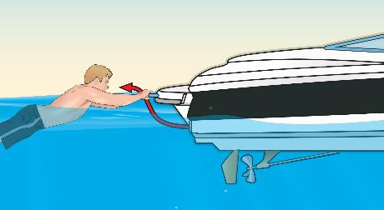
Personal Injuries
To prevent carbon monoxide poisoning:
Allow fresh air to circulate.
Keep away from engine and generator exhaust outlets.
Never sit on the back deck, “teak surf,” or hang on the swim platform.
Ventilate immediately if you detect fumes.
Install marine-rated CO detectors.
Notes:
Installation of CO detectors important, particularly in areas where people sleep, galleys, enclosed areas, etc.

Slide 39
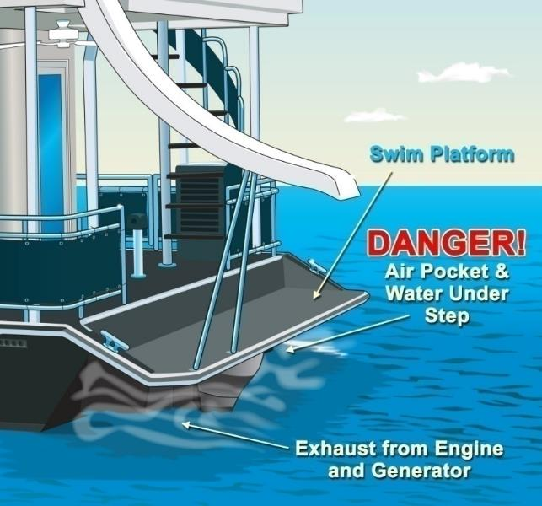
Personal Injuries
Never enter areas under swim platforms as air in these areas could be fatal if breathed in.
Notes:
Most swim platforms have slots to keep air flowing, but solid platforms keep the exhaust contained in that area and is dangerous. It can kill in seconds.

Slide 40
Personal Injuries
Before each boating trip:
Know the location of exhaust outlets.
Educate passengers about CO poisoning.
Check operation of exhaust outlets.
Listen for any change in exhaust sound.
Test each CO detector.

Slide 41
Personal Injuries
Monthly:
Make sure exhaust clamps are secure.
Look for leaks in the exhaust system.
Inspect rubber hoses for damage.
Annually:
Have a qualified technician check the engine and exhaust system.

Slide 42
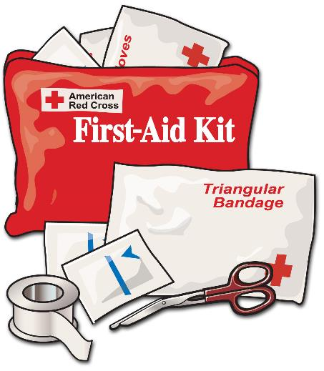
Personal Injuries
Responding to Other Serious Injuries
Shock
Bleeding
Burns
Broken Bones
Head, Neck, or Spinal Injury
Notes:
Have the students discuss what actions they would take.
Stress taking a first aid or CPR course.

Slide 43
Weather Emergencies
How to Avoid Severe Weather
Tune a radio to a station with weather updates.
Be alert to weather conditions.
Track changes in barometer readings.
Watch for wind shifts, lightning, and rough water.
Notes:
Stress:
Be alert to weather changes
Watch for wind shift
Watch for rough water
Observe weather from all directions.

Slide 44
Weather Emergencies
Be aware of weather to the west.
Watch for fog.
Head toward nearest safe shore.
Notes:
Stress:
Be alert to weather changes
Watch for wind shift
Watch for rough water
Observe weather from all directions.

Slide 45
Weather Emergencies
What to Do if Out in Severe Weather
Prepare the boat.
Slow down.
Close hatches, windows, and doors.
Stow unnecessary gear.
Turn on all navigation lights.
Keep bilges free of water.
Disconnect electrical equipment if there is lightning.

Slide 46
Weather Emergencies
Prepare your passengers for severe weather.
Make sure everyone is wearing a PFD.
Have passengers sit on floor close to centerline.
Decide whether to go to shore or ride out the storm.
Head for nearest safe shoreline.
Steer bow of boat into waves.
Keep sharp lookout for other vessels or hazards.
If engine stops, drop an anchor.
Notes:
Stress:
Put on PFD- if not already on
Reduce speed
Consider seeking shelter
Close hatches and portholes
Keep weight low

Slide 47
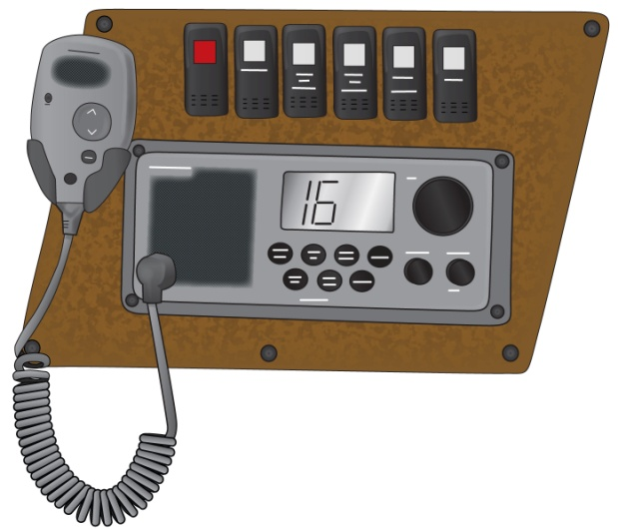
Summoning Help
Useful items:
Visual distress signals
VHF marine radio Ch. 16
Mobile phone
Emergency Position-Indicating Radio Beacon (EPIRB)
Personal Locator Beacon (PLB)
Notes:
Instructor Notes:
Distress:
MAYDAY, MAYDAY, MAYDAY
Urgency:
PANPAN, PANPAN, PANPAN
Safety:
SECURITE, SECURITE, SECURITE
If you have a marine VHF radio, you are required to monitor channel 16 when not using the radio on other channels.

Slide 48
Chapter 5 Review

Slide 49
Review Exercises
Which of these provides warning that dangerous weather is approaching?
Clear, sunny skies and no wind.
Drop in wind speed and calmer water.
White clouds and gentle waves.
d. Dark clouds and shifting winds.

Slide 50
Review Exercises
What should you do to reduce the risk of falling overboard?
Stand up when changing seats.
Move around while underway.
Keep centered in the boat.
d. Keep two points points of contact if you move.

Slide 51
Review Exercises
What should a motorboat operator do when someone is
being pulled into the boat from the water?
Put the engine in forward gear at the slowest speed.
Put the engine in reverse gear at the slowest speed.
Keep the engine idling in neutral.
d. Turn the engine off.

Slide 52
Review Exercises
Why is carbon monoxide gas dangerous?
It is flammable and ignites easily.
It creates a cloud that blocks your view of other vessels.
It causes corrosion on electrical connections that can cause sparks.
d. It is colorless, odorless, and tasteless and can be fatal.

Slide 53
Review Exercises
What is the first action required of a boat operator who
witnesses a boating accident?
To provide assistance.
Keep out of the way.
Write an accident report.
d. Wait for rescue personnel.

Slide 54
Review Exercises
Under what condition is a person at the greatest risk of
developing hypothermia?
After being in the wind for a long time.
When deprived of liquid.
When exposed to cold air.
d. When immersed in cold water.

Slide 55
Review Exercises
What should you do if you fall overboard into cold water?
Try to re-board your boat, even if it is swamped.
Remove any unnecessary clothing .
Tread water or swim around to generate heat.
d. Try to float on your stomach with legs extended.

Slide 56
End Chapter 5

